Slide 1
Analyze the Effect of Class Type on First Grade Math Scores Using Two-way ANOVA
Team 13

Slide 2
Introduction
Data
Student-Teacher Achievement Ratio (STAR)
Variables: teacher ID, class type, school ID and math scores
Drop the missing values
Question of interest
To analyze whether there is an association between class types and teachers’ teaching quality
Make causal inference between class types and teachers’ teaching quality
Notes:
Student-Teacher Achievement Ratio (STAR).
We chose teacher ID, class type, school ID and math scores as main variables based on our interests, other variables concerning teachers' characteristics have been remained also.
and we drop the missing values
Question of interest

Slide 3
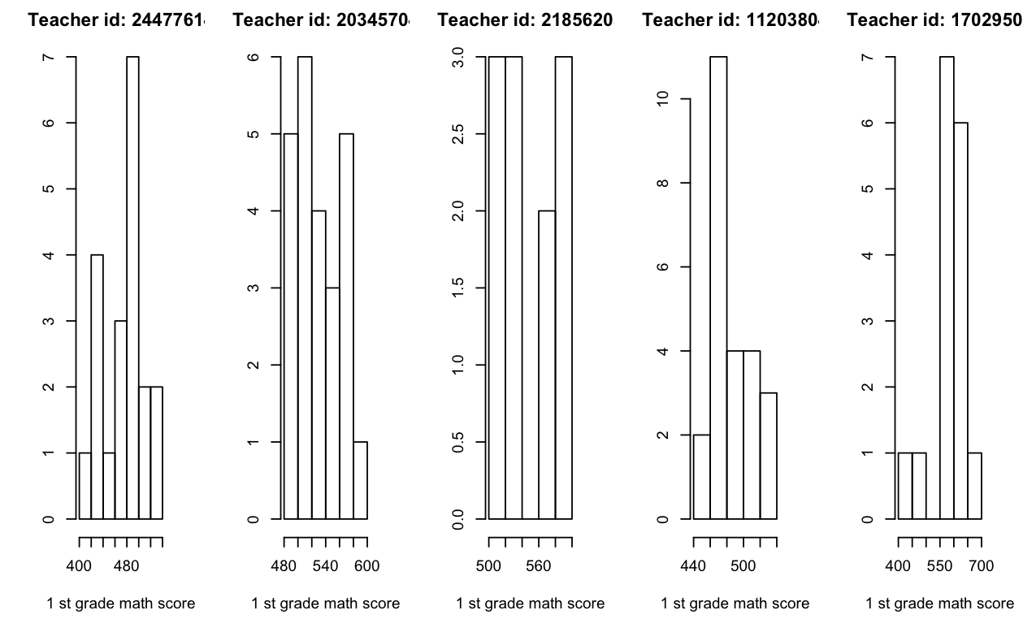
Choose the response variable
Notes:
In order to answer the questions. We first need to find a measurement for teaching quantality. we draw the plots for some teacher IDs and relevant math scores. The distributions for each teacher showed here are not normal. In addition, the mean will be affected by extrema values which are outliers. For this reason, we use the median math scores as indictor to represent the teaching quality.

Slide 4

Model
Two-way ANOVA model
$Y_{i,j,k}=μ+α_{i}+β_{j}+ε_{i,j,k}$
$α_{i}$ denotes an effect for level i of class types
$β_{j}$ denotes an effect for level j of schools
$Y_{i,j,k}$ denotes the median math scores of students in first grade taught by each teacher
Model assumption
Normality - Q-Q plot
Equal variance - Residual versus Fitted Value
Independence
Notes:
Since it is a Stratified randomized experiment, Class types are treatments; schools are blocks
We use two-way ANOVA to do analysis.
Notation
We didn’t include the interaction term since we are not interested in the interact effect and also the F test showed it is not significant to be included in our model.
Assumption

Slide 5
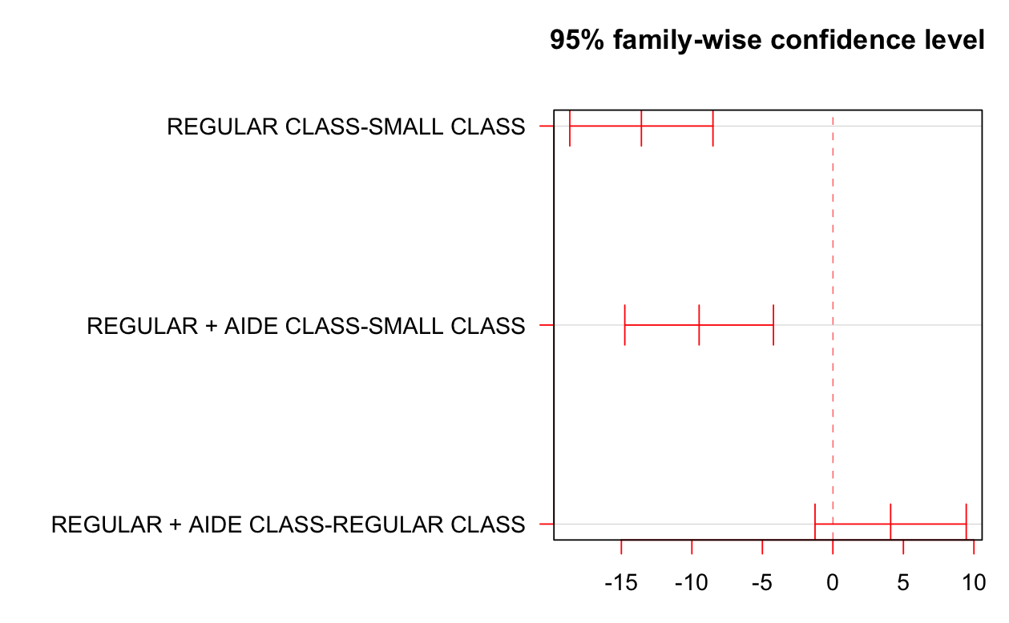

Tukey’s Pairwise Comparison
Null hypothesis $H_{ii′,0}:D_{ii′}=μ_{i}−μ_{i′}=0$
Confidence intervals:
Result: There is relationship between class types and the performance of teachers
Notes:
We did the F test to check the main effect for class types and school ID which are all statistically significant.
Tukey’s Pairwise Comparison for class type
The h0 said there is no association between
The results shows only the ci of Regular with AIDE and Regular class type contains zero that the difference of their median math score is not significant. However, the differences are significant for regular and small class type and regular + aide and small class type
Since the median math score difference is not significant, we combine Regular with AIDE and Regular class type together as new regular class type.
Based on this new data, we treat regular as control and small class type as treatment to make the causal inference

Slide 6
Potential Outcomes Framework
Assumptions
Conclusion
Class size does have an effect on first-grade teachers’ performance
Notes:
Therefore, we could use potential outcomes framework to draw causal statement

Slide 7

Fisher’s Exact P-Values(FEP)
Framework
The potential outcomes are considered fixed
Randomness comes from assignment mechanism
Sharp Null Hypothesis
$$H_{0}:Y_{K}(0)=Y_{K}(1), \text{for} \text{all} K$$
Notes:
In Fisher’s Framework, the potential outcomes are considered fixed, the only randomness comes from how treatment group and control group are assigned.
Under the null hypothesis, no-interference assumption automatically holds and all potential outcomes are known!

Slide 8

Test Statistic of FEP
$$T^{obs}=\left|\sum_{m=1}^{M}{\frac{N(m)}{N}}\left({\overline{Y}}_{1}^{obs}(m)−{\overline{Y}}_{0}^{obs}(m)\right)\right|$$
Regular class denotes as control(0) and small class denotes as treatment(1)
$K$ denotes teachers
$M$ denotes the number of schools which is 76
$N(m)$ denotes the number of classes in school $m$, $m=1,2,…M$; $N=\sum_{m=1}^{M}{N}(m)$
${\overline{Y}}_{1}^{obs}(m)$ and ${\overline{Y}}_{0}^{obs}(m)$ denote the average of observed median math score for small and regular classes in school $m$ respectively
Notes:
the within school average difference between treatment and control. It is weighted by the number of classes in each school divided by the total number of classes.
Then we need to derive the distribution of the test statistic.

Slide 9
Method of FEP
all possible assignment
all possible T value
exact distribution of T
exact p-value
Notes:
Since the assignment we observe is only one of many, by exhausting all possible assignments, we could have all possible T values and get the exact distribution of T! With this distribution, we calculate the proportion of T that are as extreme as the observed T value, which is also called the exact p-value

Slide 10
Example
There are 2 schools
School A has 1 small class and 1 regular class
School B has 2 small class and 1 regular class
Notes:
Under the null hypothesis, we know all potential outcomes and calculate the test statistics. Then we find the distribution of T. There are 6 different assignments, we calculate T value of each assignment and get the distribution of the test statistics.

Slide 11
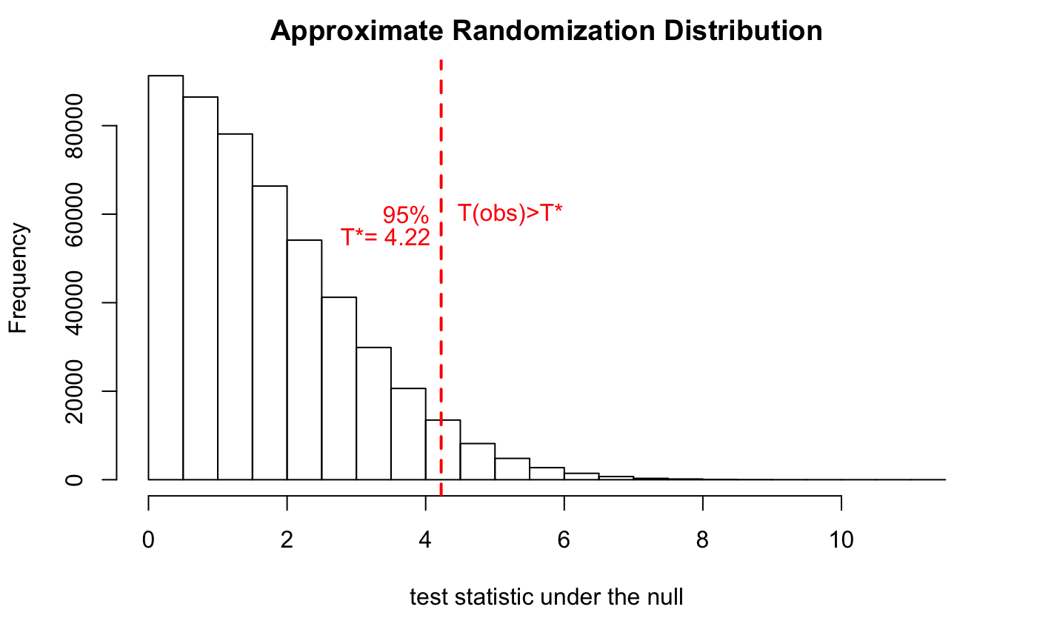
Result of STAR
Conclusion
Teachers with small classes had different performance than teachers with other type of classes
Notes:
Using similar procedures in project star, the test statistic is
and you could see the distribution of T.

Slide 12
Comparison between Two Methods
Comparison
Fisher’s Exact P-value | Potential Outcomes Framework
H0 : no individual treatment effect | H0 : no average treatment effect
SUTVA-no interference automatically holds under H0 | Check first
Reference
Causal Inference for Statistics Social and Biomedical Sciences An Introduction, Chapter 5 and Chapter 9
Notes:
First, Fisher’s method is used to test whether there is individual treatment effect, however, potential outcome focus on whether there is average treatment effect. Second, using fisher’s method, no-interference assumption automatically holds, but in potential outcomes framework, it may not hold.

Slide 13
Q&A

